Slide 1
Introduction to Statistical Methods
Dr Y V K Ravi Kumar, BITS- Pilani

Slide 2
Session 8 : Testing of Hypothesis
II Semester 2019 -20(Aug 2020)

Slide 3
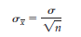
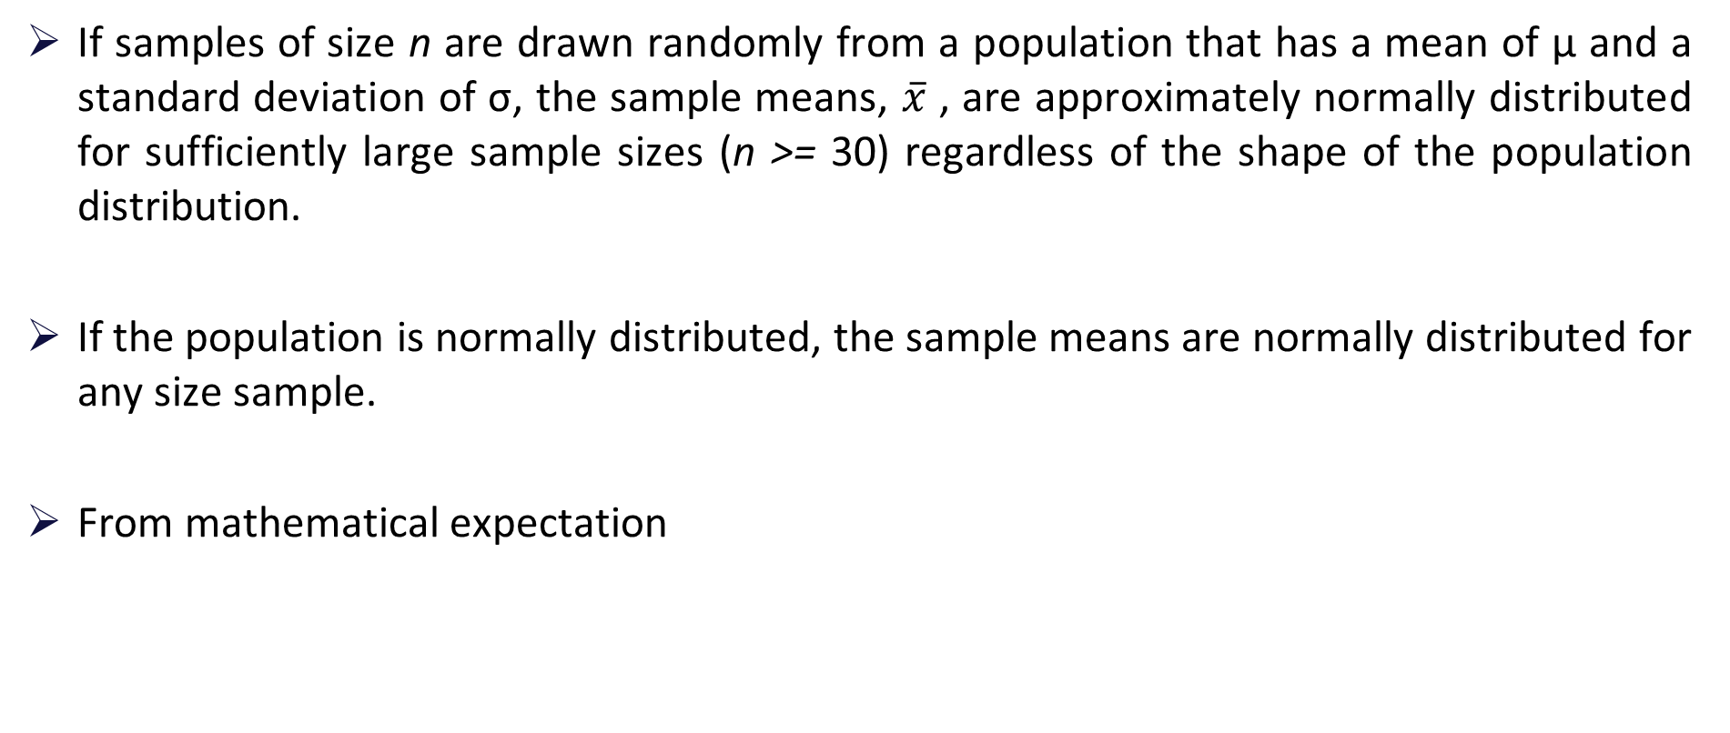
Central Limit Theorem
If samples of size n are drawn randomly from a population that has a mean of µ and a standard deviation of σ, the sample means, $\overline{x}$ , are approximately normally distributed for sufficiently large sample sizes (n >= 30) regardless of the shape of the population distribution.
If the population is normally distributed, the sample means are normally distributed for any size sample.
From mathematical expectation
Notes:
the mean of the sample means is the population mean.
and the standard deviation of the sample means (called the standard error of the mean) is the standard deviation of the population divided by the square root of the sample size.

Slide 5
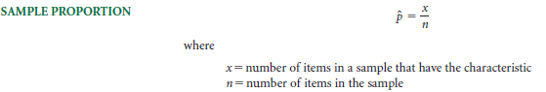
Sampling Distribution Of Sample Proportion
If research results in countable items such as how many people in a sample have a flexible work schedule, the sample proportion is often the statistic of choice.
Notes:
If research produces measurable data such as weight, distance, time, and income,
the sample mean is often the statistic of choice. However, if research results in countable
items such as how many people in a sample choose Dr. Pepper as their soft drink or how
many people in a sample have a flexible work schedule, the sample proportion is often the
statistic of choice.

Slide 6
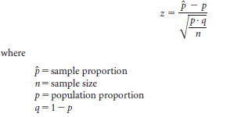
Z Formula For Sample Proportions
For n*p > 5 and n*q > 5

Slide 7
Example
Suppose 60% of the electrical contractors in a region use a particular brand of wire.
What is the probability of taking a random sample of size 120 from these electrical contractors and finding that .50 or less use that brand of wire?

Slide 8
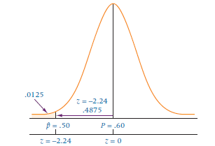
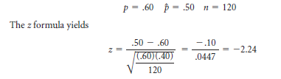
Solution
The probability corresponding to z = -2.24 is .4875.
For z < -2.24 (the tail of the distribution), the answer is .5000 - .4875 = .0125.

Slide 9
Exercise
If 10% of a population of parts is defective, what is the probability of randomly selecting 80 parts and finding that 12 or more parts are defective?

Slide 10
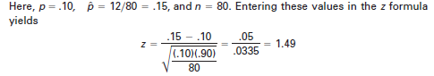
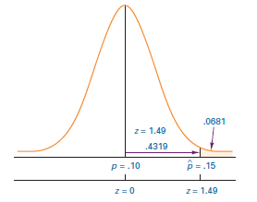
Solution
The probability of .4319 for a z value of 1.49, which is the area between the sample proportion, .15, and the population proportion, .10. The answer to the question is

Slide 11
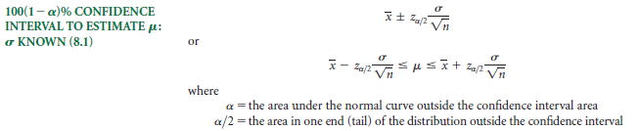
Confidence Interval to Estimate µ
Notes:
It is not certain that the population mean is in the interval unless we have a 100% confidence interval that is infinitely wide.
If we want to construct a 95% confidence interval, the level of confidence is 95%, or .95.

Slide 12
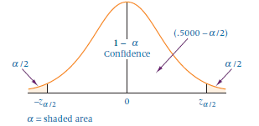
Confidence Intervals

Slide 13
Exercise
A survey was taken of U.S. companies that do business with firms in India. One of
the questions on the survey was: Approximately how many years has your company
been trading with firms in India?
A random sample of 44 responses to this question yielded a mean of 10.455 years. Suppose the population standard deviation for this question is 7.7 years.
Using this information, construct a 90% confidence interval for the mean number of years that a company has been trading in India for the population of U.S. companies trading with firms in India.

Slide 14
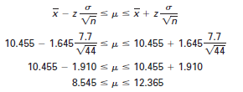
Solution

Slide 15
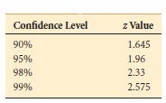
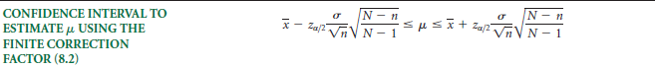
Finite correction factor
Values of z for Common
Levels of Confidence
Notes:
For finite population

Slide 16
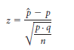
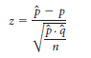
Estimating The Population Proportion
Methods similar to those used earlier can be used to estimate the population proportion.
The central limit theorem for sample proportions led to the following formula
where q = 1 - p. Recall that this formula can be applied only when n*p and n*q are greater than 5.
for confidence interval purposes only and for large sample sizes— is substituted for p in the denominator, yielding
Notes:
When the variable of interest is categorical, the population parameter that we will infer about is the population proportion (p) associated with that variable.
When the variable of interest is quantitative, the population parameter that we infer about is the population mean (μ) associated with that variable.

Slide 17
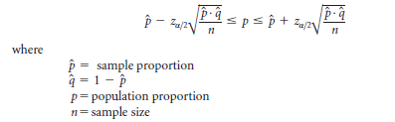
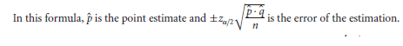
Confidence Interval To Estimate P
Notes:
Because we are not using the true standard deviation of sample proportion, the correct divisor of the standard error of sample proportion is n - 1.
However, for large sample sizes, the effect is negligible. Although technically the minimal sample size for the techniques
presented in this section is n*p and n*q greater than 5, in actual practice sample sizes of several hundred
are more commonly used. As an example, for and of .50 and n = 300, the standard error of is .02887 using
n and .02892 using n - 1, a difference of only .00005.

Slide 18
Example
A study of 87 randomly selected companies with a telemarketing operation revealed that 39% of the sampled companies used telemarketing to assist them in order processing.
Using this information, how could a researcher estimate the population proportion of telemarketing companies that use their telemarketing operation to assist them in order processing?

Slide 19
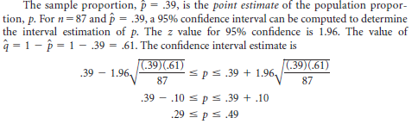
Solution

Slide 20
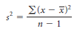
Estimating The Population Variance
Sample variance is computed by using the formula
Mathematical adjustment is made in the denominator by using n - 1 to make the sample variance an unbiased estimator of the population variance.
Suppose a researcher wants to estimate the population variance from the sample variance in a manner that is similar to the estimation of the population mean from a sample mean.
The relationship of the sample variance to the population variance is captured by the chi-square distribution
Notes:
Estimating the variance is important in many other instances in business. For example,
variations between airplane altimeter readings need to be minimal. It is not enough just
to know that, on the average, a particular brand of altimeter produces the correct altitude.
It is also important that the variation between instruments be small.

Slide 21
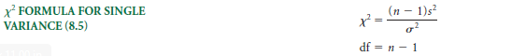
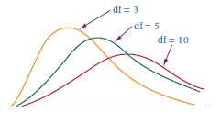
Chi-square Statistic
Although the technique is still rather widely presented as a mechanism for constructing confidence intervals to estimate a population variance, you should proceed with extreme caution and apply the technique only in cases where the population is known to be normally distributed.
Three Chi-Square Distributions
Notes:
The chi-square distribution is not symmetrical, and its shape will vary according to the degrees of freedom

Slide 22
Testing of Hypothesis

Slide 23
Example
A telecom service provider claims that individual customers pay on an average Rs.400 per month with a standard deviation of Rs.25,
A random sample of 50 customers bills during a given month is with a mean of Rs.250 with a SD of Rs.15.
What to say w.r.t the claim made by the service provider?

Slide 24
Example
A telecom service provider claims that individual customers pay on an average at least Rs.400 per month with a standard deviation of Rs.25,
A random sample of 50 customers bills during a given month is with a mean of Rs.250 with a SD of Rs.15.
What to say w.r.t the claim made by the service provider?

Slide 25
Example
From the Data available, it is observed that 400 out of 850 customers purchased groceries online.
Can we say that most of the customers are moving towards online shopping even for groceries?

Slide 27
Example
Following is the record of number of accident took place during the various days of the week
Can we conclude that accident is independent of the day in a week?
MONDAY | Tuesday | Wednesday | Thursday | Friday | Saturday | Sunday
184 | 148 | 145 | 153 | 150 | 154 | 116

Slide 28
Example
Can we conclude that smoking causes cancer?
 | With Cancer | Without Cancer | Total
Smokers | 400 | 300 | 700
Non Smokers | 300 | 500 | 800
TOTAL | 700 | 800 | 1500

Slide 38
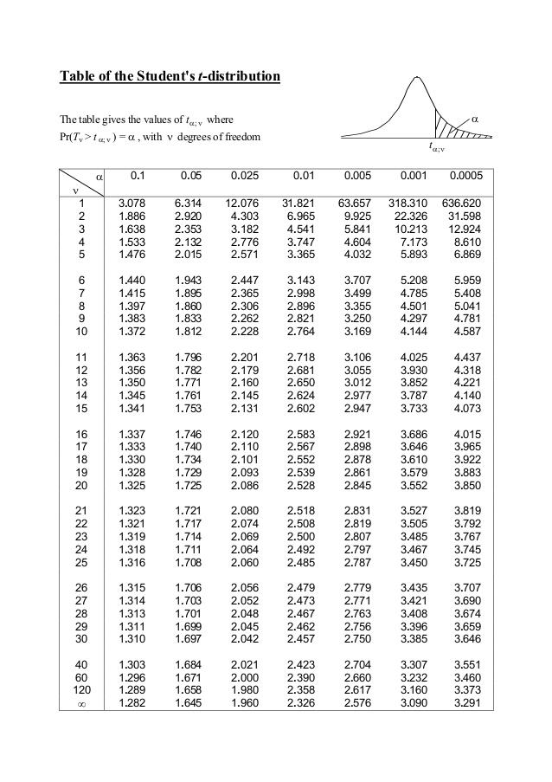

Slide 39
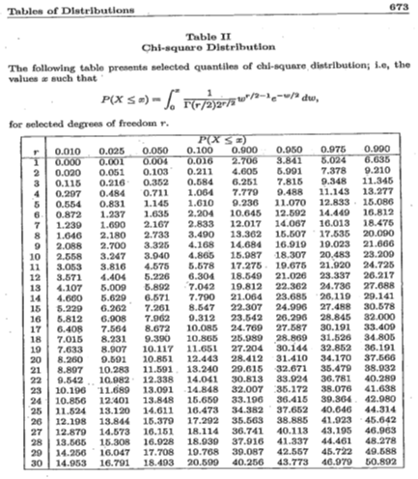

Slide 41
It is claimed that the mean of the population is 67 gms at 5% level of significance. Mean obtained from a random sample of size 100 is 64 with SD 3. Validate the claim.

Slide 42
It is claimed that the mean of the population is 67 gms at 5% level of significance. Mean obtained from a random sample of size 100 is 64 with SD 3. Validate the claim.

Slide 43
Example
A telecom service provider claims that individual customers pay on an average at least Rs.400 per month with a standard deviation of Rs.25,
A random sample of 50 customers bills during a given month is with a mean of Rs.250 with a SD of Rs.15.
What to say w.r.t the claim made by the service provider?

Slide 44
Example
There is an assumption that there is no significant difference between boys and girls wrt intelligence. Tests are conducted on two groups and the following are the observations
Mean. SD. Size
Girls. 75. 8. 60
Boys. 73. 10. 100
Validate this at 5% LoS

Slide 45
Example
There is an assumption that there is no significant difference between boys and girls wrt intelligence. Tests are conducted on two groups and the following are the observations
Mean. SD. Size
Girls. 75. 8. 60
Boys. 73. 10. 100
Validate this at 5% LoS

Slide 49
Example 5
As a manager of finance you are assigned the task of choosing the best product in terms of life of the product.
Product A: Mean 1456 hours with SD 423, size 10
Product B: Mean 1280 hours with SD 398, size 17
Use 5% level of significance.

Slide 50
Example 5
As a manager of finance you are assigned the task of choosing the best product in terms of life of the product.
Product A: Mean 1456 hours with SD 423, size 10
Product B: Mean 1280 hours with SD 398, size 17
Use 5% level of significance.

Slide 51
Example 5
As a manager of finance you are assigned the task of choosing the best product in terms of life of the product.
Product A: Mean 1456 hours with SD 423, size 10
Product B: Mean 1280 hours with SD 398, size 17
Use 5% level of significance.

Slide 53
Example
It is found that 290 errors in the randomly selected 400 lines of code from Team A, and 160 errors in 300 lines of code from Team B
Can we assume that team B’s performance is superior to that of team A?

Slide 54
Example
Following is the record of number of accident took place during the various days of the week
Can we conclude that accident is independent of the day in a week?
MONDAY | Tuesday | Wednesday | Thursday | Friday | Saturday | Sunday
184 | 148 | 145 | 153 | 150 | 154 | 116

Slide 56
Example
Can we conclude that smoking causes cancer?
 | With Cancer | Without Cancer | Total
Smokers | 400 | 300 | 700
Non Smokers | 300 | 500 | 800
TOTAL | 700 | 800 | 1500

Slide 62
Thanks

Slide 68
Thanks

